Slide 1
Subtyping of Metabolic and Lipidomic
苏航
2024-08-22

Slide 2
Metabolism Subtyping

Slide 3
Data Description
101 Samples
Data Preprocess
171 metabolites
Log
Norm
Dimension Reduction
Not done since 171 is a relatively low dimension

Slide 4
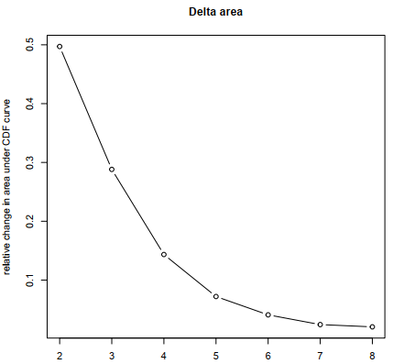
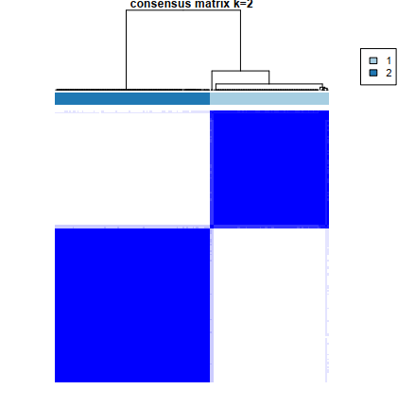
Decide K=2
Evidence shows that 2 is the best cluster number
As the number of clusters increases, clustering consistence drops
Heatmaps obtained using 3-clusters do not have boundaries as clear as 2-clusters

Slide 5
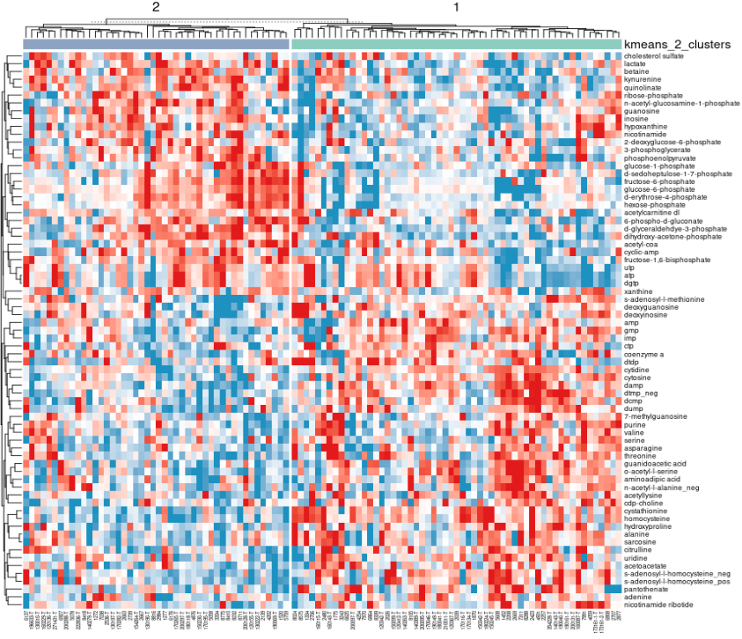
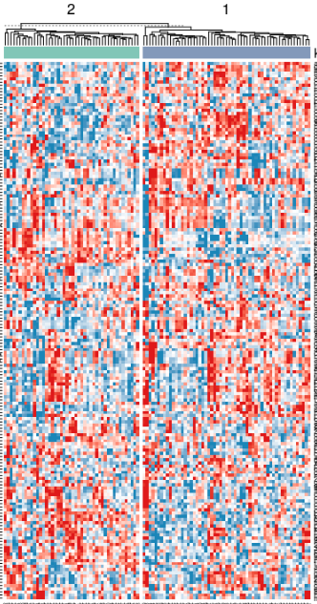
Heatmap

Slide 6
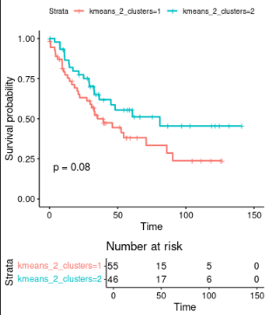
Survival Result
101 Samples

Slide 7
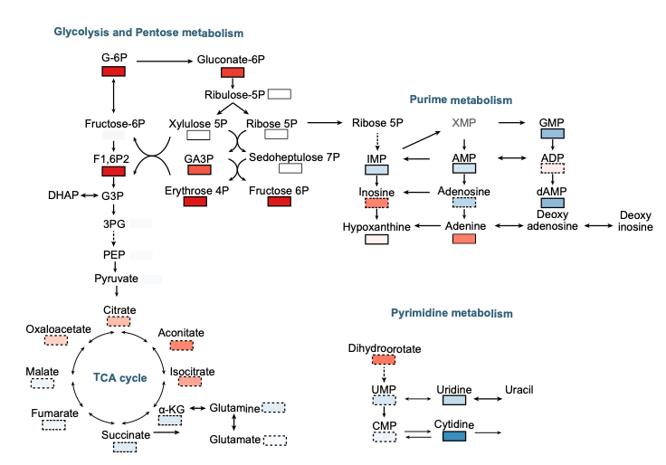
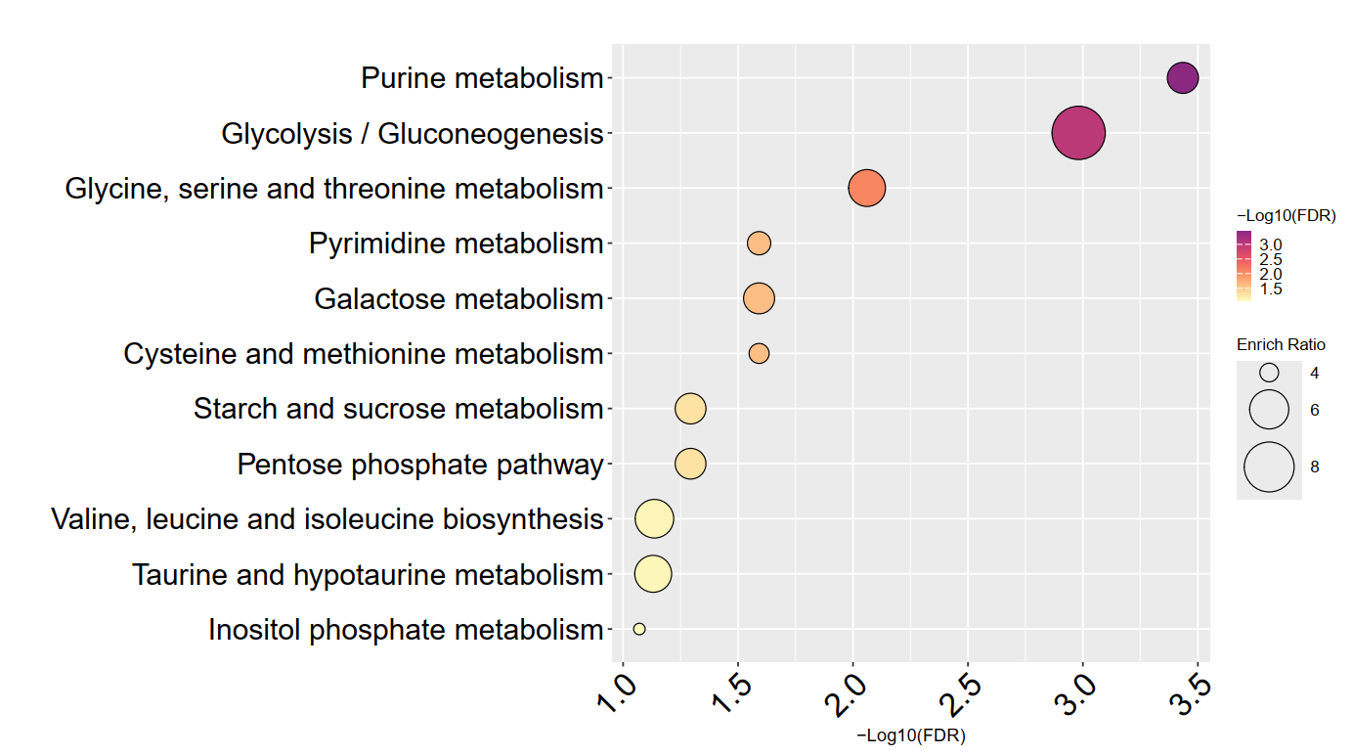
KEGG Enrichment and Pathway

Slide 8
Lipidomic Subtyping

Slide 9
Data Description
106 Samples
Preprocess
574 lipids
Log
Norm
Delete Odd Chain
Dimension Reduction
PCA
49 PCs, explaining 90% PCA variance

Slide 10
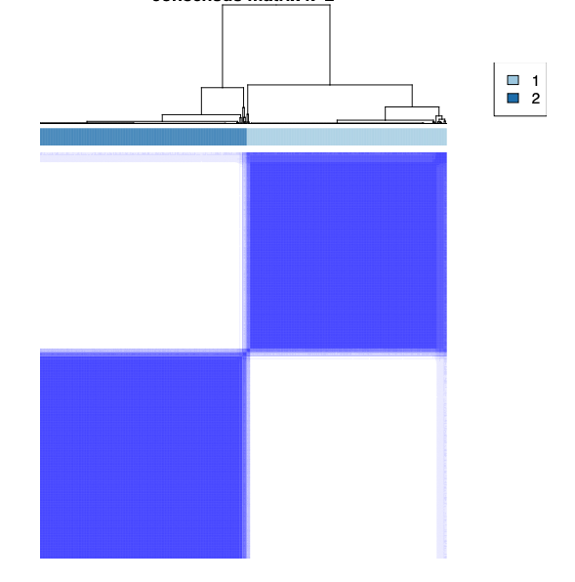
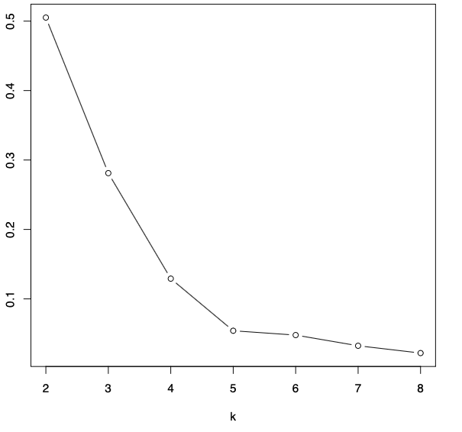
Decide K=2
Evidence shows that 2 is the best cluster number
As the number of clusters increases, clustering consistence drops

Slide 11
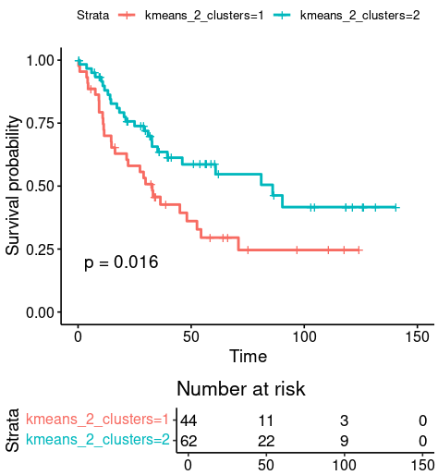
Survival

Slide 12
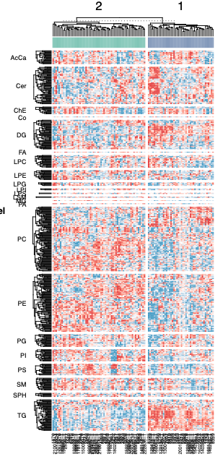
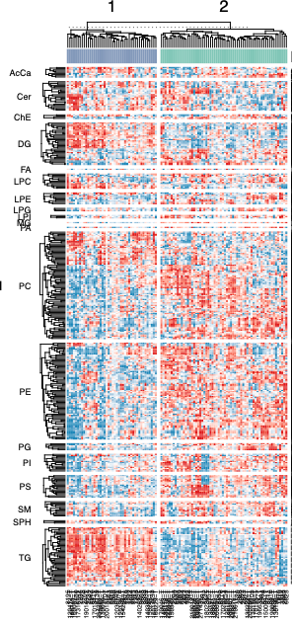
Heatmap

Slide 13
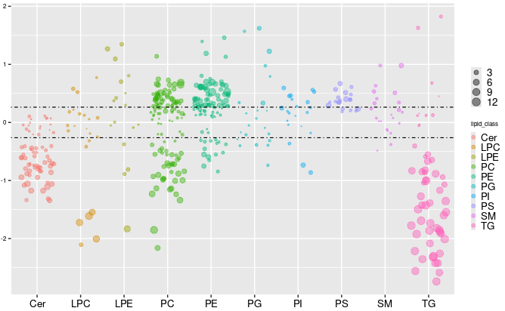
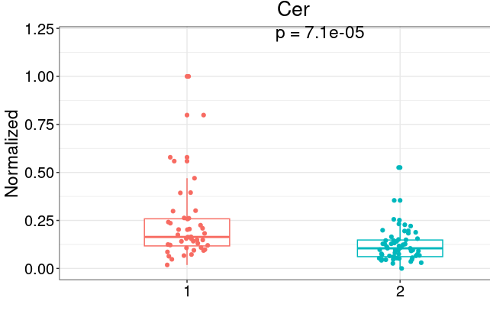
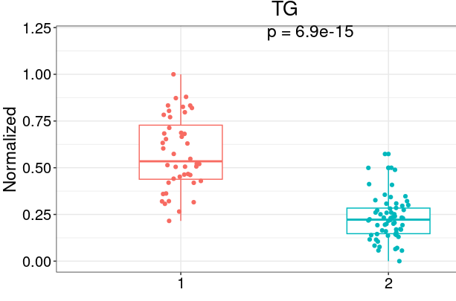
Landscape
Based on Clustering
2 compared to 1 (high to low)
Down: Cer, TG

Slide 14
Survival Prediction

Slide 15
Data Description
Metabolic Dataset
Whole dataset
101 samples
171 metabolites, 6 selected
Chemotherapy Dataset
76 samples
171 metabolites, 4 selected
Lipid Dataset
Chemotherapy Dataset
80 samples
750 metabolites, 9 selected

Slide 16
Metabolic

Slide 17
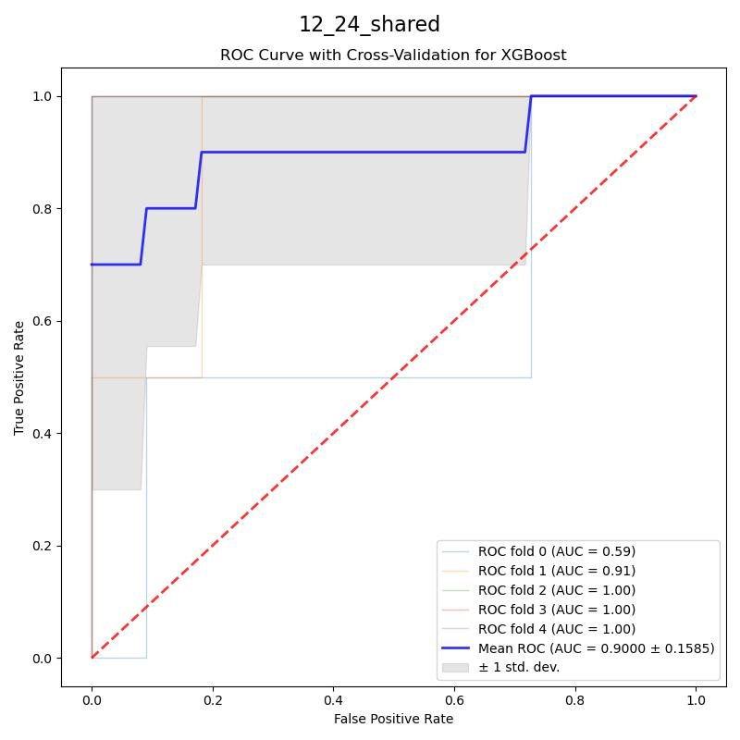
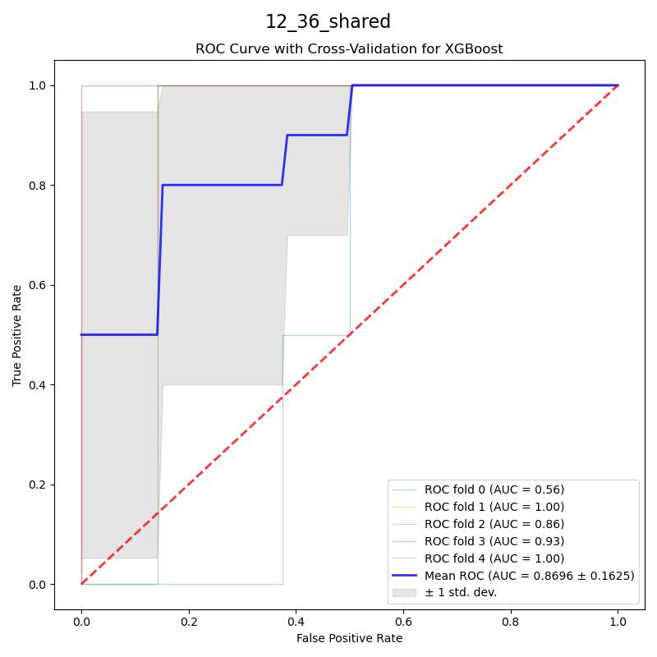
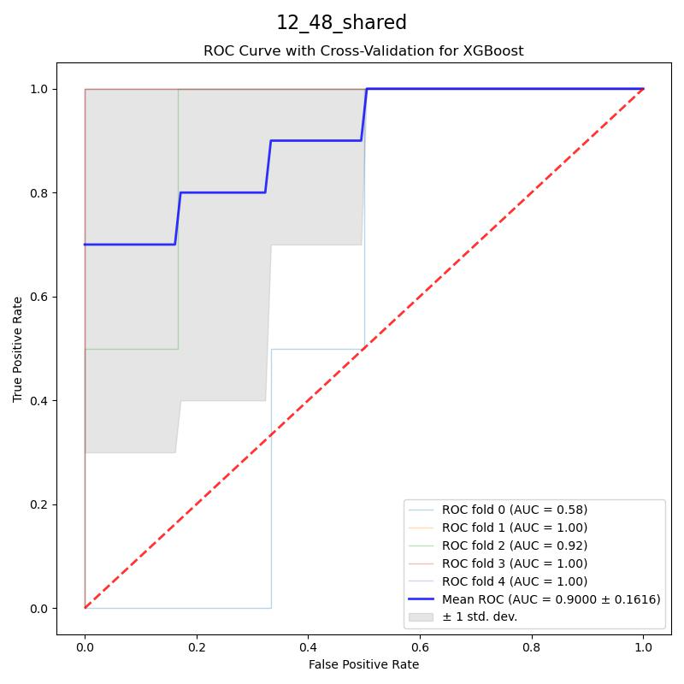
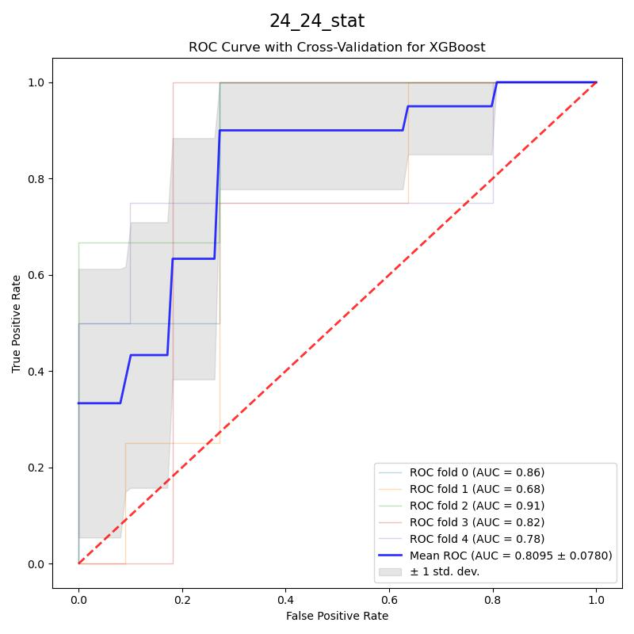
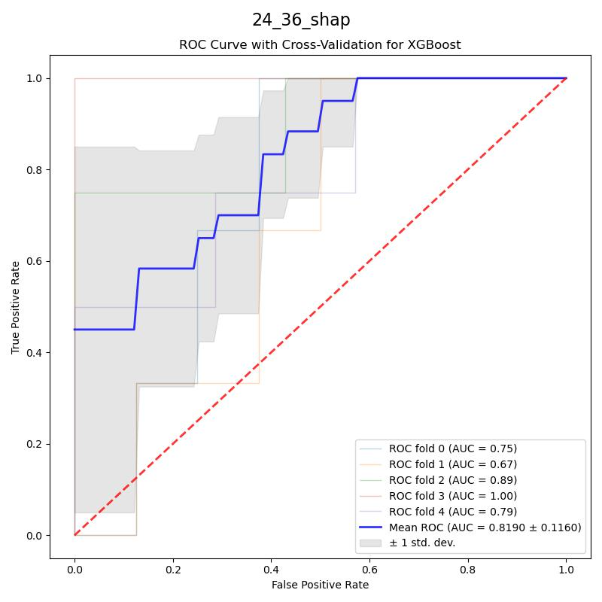
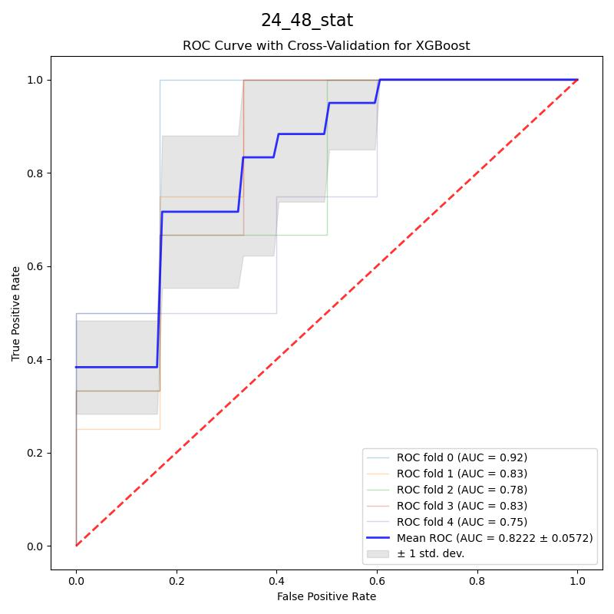
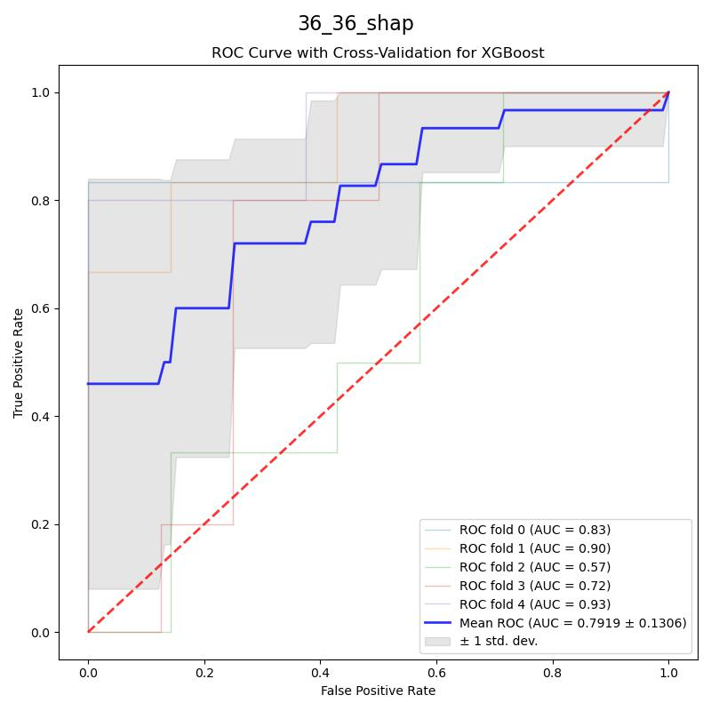
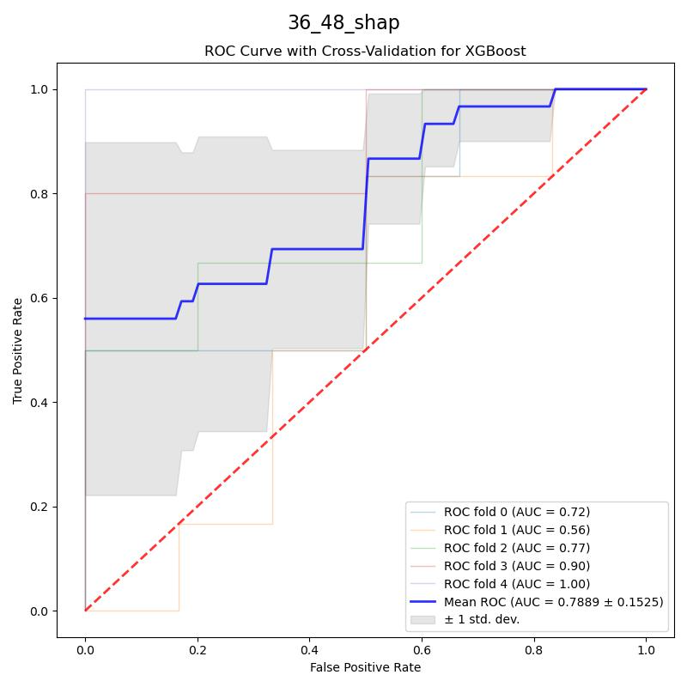
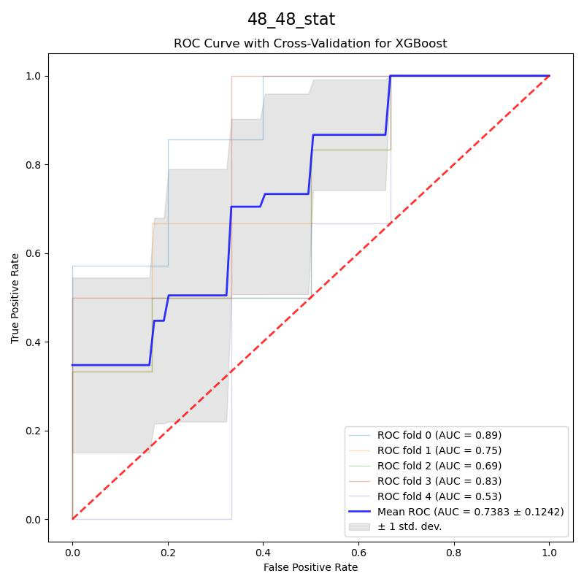

Slide 18
Lipidomic

Slide 20
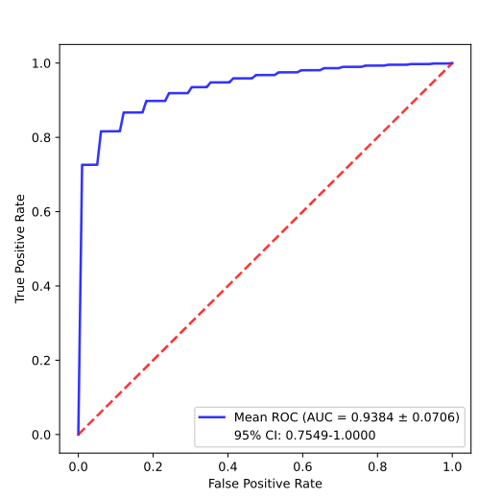
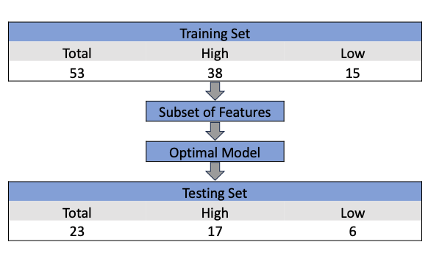
Lipidomic-24-24

Slide 21
